Slide 1
Tomada de decisão
2

Slide 2
Objetivos
Descrever as oito etapas do processo de tomada de decisão.
Explicar a relação das decisões com as quatro funções de gestão
Tipificar as decisões e as condições de tomada de decisão.
Descrever os diferentes estilos de tomada de decisão e discutir como pode o processo de tomada de decisão ser enviesado.
Identificar as técnicas de tomada de decisões eficazes.

Slide 3
A key to success in management and in your career is knowing how to be an effective decision-maker.

Slide 4
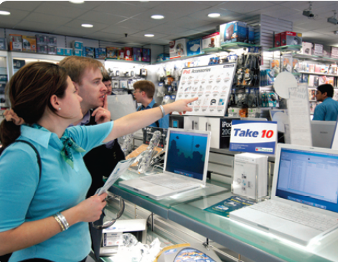
The Decision-Making Process
Decisão
Optar entre duas ou mais alternativas.
Notes:
Managers at all levels and in all areas of organizations make decisions. That is, they make choices. Although decision-making is typically described as choosing among alternatives, this view is too simplistic. Why? Because decision-making is (and should be) a process, not just a simple act of choosing among alternatives.

Slide 5
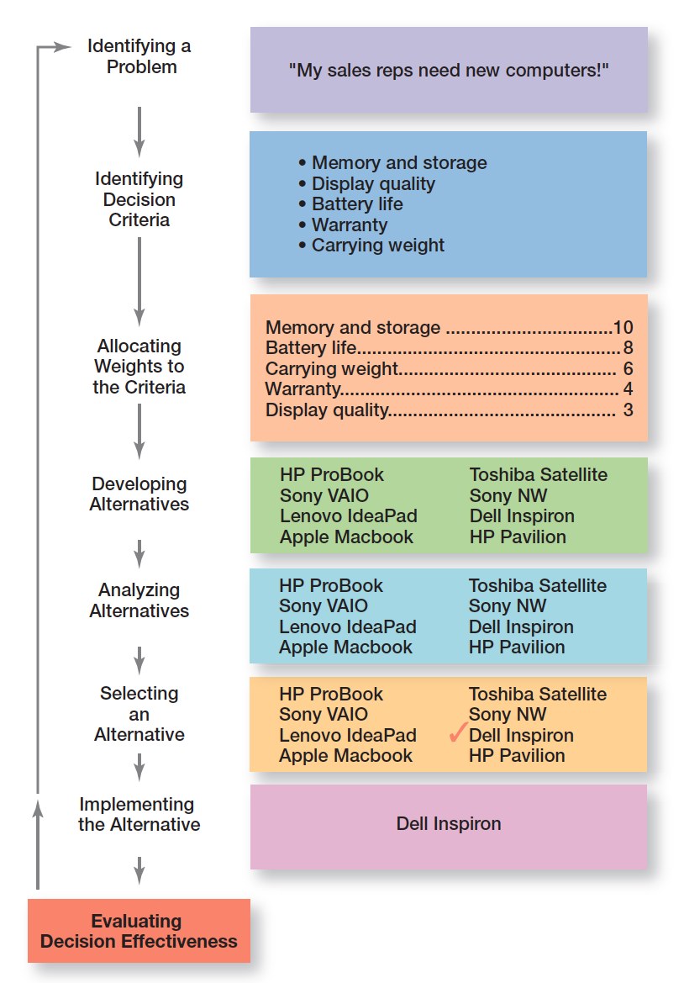
Figura 2-1
O Processo de tomada de decisão

Slide 6
O processo de tomada de decisão (cont.)
Etapa 1: Identificar o Problema
  Problema: um obstáculo que dificulta a obtenção de um resultado desejado
  Todas as decisões começam com um problema, uma discrepância entre as condições desejadas e as existentes.
  Exemplo: A Joana é uma gestora de vendas e os seus vendedores precisam de novos portáteis.
Notes:
Every decision starts with a problem, a discrepancy between an existing and a desired condition. For our example, Amanda is a sales manager whose reps need new laptops because their old ones are outdated and inadequate for doing their job. To make it simple, assume it’s not economical to add memory to the old computers and it’s the company’s policy to purchase, not lease. Now we have a problem—a disparity between the sales reps’ current computers (existing condition) and their need to have more efficient ones (desired condition). Amanda has a decision to make.

Slide 7
O processo de tomada de decisão (cont.)
Etapa 2: Identificar os Critérios de Decisão
- Critérios de decisão: são fatores que são importantes (relevantes) para resolver o problema.
Exemplo: A Joana decide que a memória e capacidade de armazenamento, a qualidade do ecrã, a duração da bateria, garantia e o peso são os critérios relevantes para a sua decisão.
Notes:
Once a manager has identified a problem, he or she must identify the decision criteria important or relevant to resolving
the problem. Every decision maker has criteria guiding his or her decisions even if they’re not explicitly stated. In our example,
Amanda decides after careful consideration that memory and storage capabilities, display quality, battery life, warranty, and carrying weight are the relevant criteria in her decision.

Slide 8
O processo de tomada de decisão (cont.)
Etapa 3: Atribuir uma ponderação para cada um dos critérios
Se os critérios relevantes não são igualmente importantes, o decisor deve atribuir um peso diferenciado para cada critério. Um peso que permita acomodar essas diferentes prioridades, na tomada de decisão.
Os critérios ponderados para o nosso exemplo são mostrados na Figura 2-2.
Notes:
If the relevant criteria aren’t equally important, the decision maker must weight the items in order to give them the correct
priority in the decision. How? A simple way is to give the most important criterion a weight of 10 and then assign weights to the rest using that standard. Of course, you could use any number as the highest weight. The weighted criteria for our example is shown in Exhibit 2-2.

Slide 9
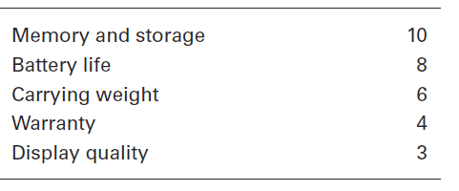
Figura 2-2
Critérios de decisão relevantes

Slide 10
O processo de tomada de decisão (cont.)
Etapa 4: Desenvolver as Alternativas
  Listar alternativas viáveis ​​que poderiam resolver o problema.
  Exemplo: A Joana, identificou oito portáteis como possíveis escolhas. (Vide Figura 2-3).
Notes:
The fourth step in the decision-making process requires the decision maker to list viable alternatives that could resolve the problem. In this step, a decision maker needs to be creative, and the alternatives are only listed—not evaluated—just yet. Our sales manager, Amanda, identifies eight laptops as possible choices. (See Exhibit 2-3.)

Slide 11
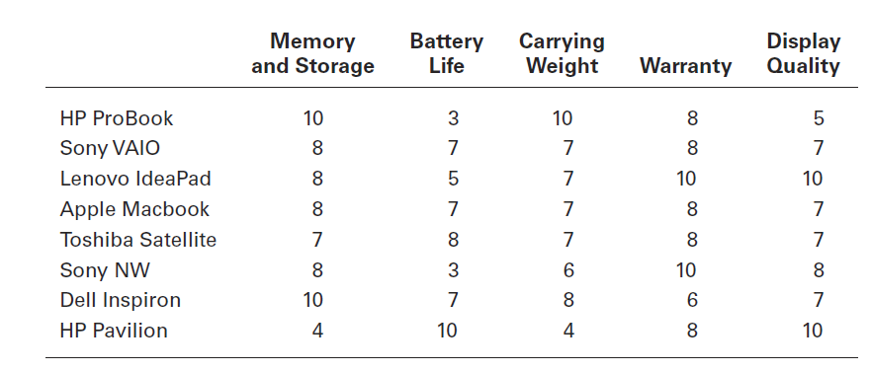
figura 2-3
Alternativas

Slide 12
O processo de tomada de decisão (cont.)
Etapa 5: Análise das Alternativas
  Avaliar os pontos fortes e fracos de cada alternativa.
  A avaliação de uma alternativa é baseada na sua capacidade de resolver os problemas relacionados com os critérios e a sua importância relativa (ponderadores).
Notes:
Once alternatives have been identified, a decision maker must evaluate each one. How? By using the criteria established in Step 2. Exhibit 2-3 shows the assessed values that Amanda gave each alternative after doing some research on them. Keep in mind that this data represents an assessment of the eight alternatives using the decision criteria, but not the weighting. When you multiply each alternative by the assigned weight, you get the weighted alternatives as shown in Exhibit 2-4. The total score for each alternative, then, is the sum of its weighted criteria.
Sometimes a decision maker might be able to skip this step. If one alternative scores highest on every criterion, you wouldn’t need to consider the weights because that alternative would already be the top choice. Or if the weights were all equal, you could evaluate an alternative merely by summing up the assessed values for each one. (Look again at Exhibit 2-3.) For example, the score for the HP ProBook would be 36, and the score for the Sony NW would be 35.

Slide 13
O processo de tomada de decisão (cont.)
Etapa 6: Seleção da melhor Alternativa
É escolhida a alternativa que maior resultado esperado apresente, na satisfação de todos de todos os critérios, devidamente ponderados pela sua importância relativa.
Notes:
The sixth step in the decision-making process is choosing the best alternative or the one that generated the highest total in Step 5. In our example (Exhibit 2-4), Amanda would choose the Dell Inspiron because it scored higher than all other alternatives (249 total).

Slide 14
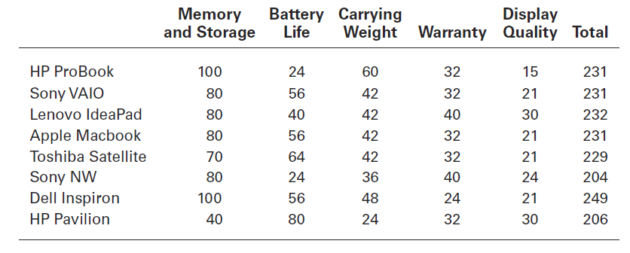
figura 2-4
Avaliação das Alternativas

Slide 15
O processo de tomada de decisão (cont.)
Etapa 7: Implementar a melhor Alternativa
  - Colocar em ação a melhor alternativa.
  - Comunicando a decisão e ganhando o compromisso de quem a irá implementar.
Notes:
In Step 7 in the decision-making process, you put the decision into action by conveying it to those affected and getting their commitment to it. We know that if the people who must implement a decision participate in the process, they’re more likely to support it than if you just tell them what to do. Another thing managers may need to do during implementation is reassess the environment for any changes, especially if it’s a long-term decision. Are the criteria, alternatives, and choice still the best ones, or has the environment changed in such a way that we need to reevaluate?

Slide 16
O processo de tomada de decisão (cont.)
Etapa 8: Avaliação da eficácia da decisão
A eficácia da decisão é julgada pelos seus resultados.
  Qual o nível de resolução do problema, resultante da implementação da(s) alternativa(s) escolhida(s)?
  - Se o problema não foi resolvido, o que é que correu mal?
Notes:
The last step in the decision-making process involves evaluating the outcome or result of the decision to see whether the problem was resolved. If the evaluation shows that the problem still exists, then the manager needs to assess what went wrong. Was the problem incorrectly defined? Were errors made when evaluating alternatives? Was the right alternative selected but poorly implemented? The answers might lead you to redo an earlier step or might even require starting the whole process over.

Slide 17
Figura 2-5
Exemplo de decisões de gestão
Planeamento
Quais são os objetivos de longo prazo da organização?
Quais as melhores estratégias para atingir esses objetivos?
Quais deveriam ser os objetivos de curto prazo da organização?
Qual deveria ser o nível de dificuldade dos objetivos individuais?
Notes:
Although everyone in an organization makes decisions, decision-making is particularly important to managers. As Exhibit 6-5 shows, it’s part of all four managerial functions. In fact, that’s why we say that decision-making is the essence of management. And that’s why managers—when they plan, organize, lead, and control—are called decision makers.

Slide 18
Figura 2-5
Exemplo de decisões de gestão
Organização
Quantos empregados deveria eu ter a reportarem diretamente a mim?
Qual o nível de centralização que a organização deveria ter?
Como deveriam ser concebidas as funções de cada empregado?
Quando deveria a organização implementar uma estrutura diferente?
Notes:
Although everyone in an organization makes decisions, decision-making is particularly important to managers. As Exhibit 6-5 shows, it’s part of all four managerial functions. In fact, that’s why we say that decision-making is the essence of management. And that’s why managers—when they plan, organize, lead, and control—are called decision makers.

Slide 19
Figura 2-5
Exemplo de decisões de gestão
Direção
Como é que eu devo lidar com empregados que parecem não estar motivados?
Qual é o estilo de liderança mais apropriado para uma dada situação?
Como é que uma alteração específica vai afetar a produtividade dos empregados?
Quando é que é apropriado estimular o conflito?

Slide 20
Figura 2-5
Exemplo de decisões de gestão
Controlo
Que atividades é que necessitam de ser controladas na organização?
Como deveriam essas atividades ser controladas?
Quando é que se considera que ocorreu um desvio significativo (relevante)?
Que tipo de sistema de informação deveria a organização ter?

Slide 21
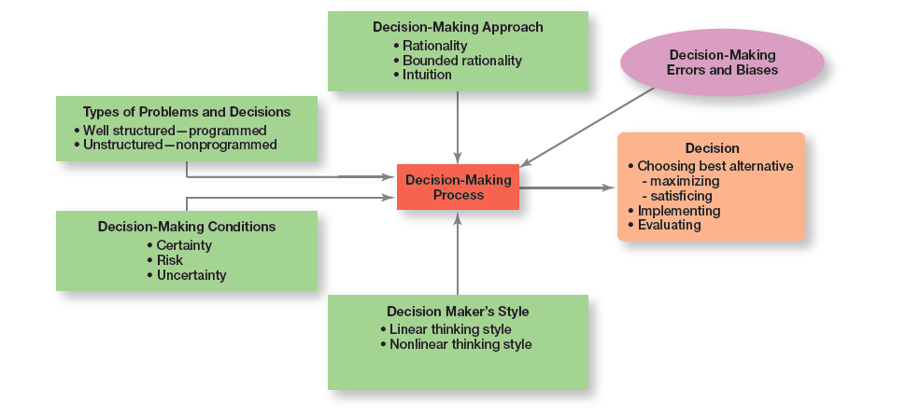
Figura 2-12 perspeCtiva geral sobre o processo de tomada de decisão
Notes:
Exhibit 2-12 provides an overview of managerial decision-making. Because it’s in their best interests, managers want to make good
decisions— that is, choose the “best” alternative, implement it, and determine whether it takes care of the problem, which is the reason the decision was needed in the first place.

Slide 22
Tomada de decisão: Racionalidade
Tomada de decisão
Descreve as opções que são lógicas e consistentes e que maximizam o valor.
Pressupostos da Racionalidade
  O decisor seria completamente objetivo e lógico;
  O problema seria claro e sem qualquer tipo de ambiguidade associada;
  O decisor teria uma visão clara sobre o objetivo específico e seria conhecedor de todas as alternativas possíveis e as suas consequências e selecionaria a de forma consistente a opção ótima.
Notes:
We assume that managers will use rational decision-making; that is, they’ll make logical and consistent choices to maximize value. After all, managers have all sorts of tools and techniques to help them be rational decision makers. Managers aren’t always rational. What does it mean to be a “rational” decision maker? A rational decision maker would be fully objective and logical. The problem faced would be clear and unambiguous, and the decision maker would have a clear and specific goal and know all possible alternatives and consequences. Finally, making decisions rationally would consistently lead to selecting the alternative that maximizes the likelihood of achieving that goal.

Slide 23
Tomada de decisão: Racionalidade limitada
Racionalidade Limitada – O processo de tomada de decisão é racional, mas limitado pela capacidade do individuo em processar a informação.
Critério da suficiência – aceitar soluções que são suficientemente boas. (boas vs. ótimas)
Tópico relacionado
Escalada do comprometimento – um aumento do comprometimento em relação a uma decisão passada, apesar da evidência de que esta poderá não ter sido a melhor.
Notes:
A more realistic approach to describing how managers make decisions is the concept of bounded rationality, which says that managers make decisions rationally, but are limited (bounded) by their ability to process information. Because they can’t possibly analyze all information on all alternatives, managers satisfice, rather than maximize. That is, they accept solutions that are “good enough.” They’re being rational within the limits (bounds) of their ability to process information.
However, keep in mind that their decision-making is also likely influenced by the organization’s culture, internal politics, power considerations, and by a phenomenon called escalation of commitment, an increased commitment to a previous decision despite evidence that it may have been wrong.

Slide 24
Bounded rationality model
(Herbert Simon)
Satisficing
Manager
Possible solutions
Evaluation
Chosen solution

Slide 25

Tomada de decisão: A intuição
A Intuição no processo de tomada de decisão
  Tomar decisões com base na experiência e nos sentimentos.
Notes:
What is intuitive decision making? It’s making decisions on the basis of experience, feelings, and accumulated judgment. Researchers studying managers’ use of intuitive decision-making have identified five different aspects of intuition, which are described in Exhibit 6-6.

Slide 26
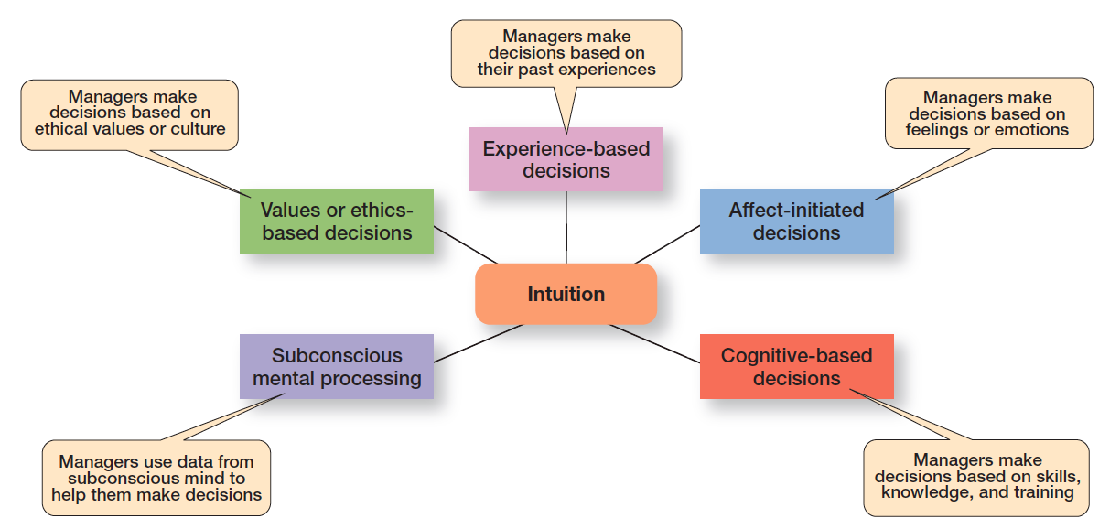
Figura 2-6
O que é a intuição?

Slide 27
TOMADA DE DECISÃO: DECISÃO BASEADA EM EVIDÊNCIA
Gestão baseada em Evidência (EBMgt)
Uso sistemático da melhor evidência para melhorar a prática da gestão.
Notes:
“Any decision-making process is likely to be enhanced through the use of relevant and reliable evidence, whether it’s buying someone a birthday present or wondering which new washing machine to buy.” That’s the premise behind evidence-based management (EBMgt), the “systematic use of the best available evidence to improve management practice.
EBMgt is quite relevant to managerial decision-making. The four essential elements of EBMgt are the decision maker’s expertise and judgment; external evidence that’s been evaluated by the decision maker; opinions, preferences, and values of those who have a stake in the decision; and relevant organizational (internal) factors such as context, circumstances, and organizational members.

Slide 28
PROBLEMAS ESTRUTURADOS E
DECISÕES PROGRAMADAS
Problemas Estruturados
Imediatos/simples, familiares e facilmente definidos.
Decisões Programadas
Uma decisão repetida que pode ser tomada com base numa rotina.
Notes:
Some problems are straightforward. The decision maker’s goal is clear, the problem is familiar, and information about the problem is easily defined and complete. Such situations are called structured problems because they’re straightforward, familiar, and easily defined. Because it’s not an unusual occurrence, there’s probably some standardized routine for handling it. This is what we call a programmed decision, a
repetitive decision that can be handled by a routine approach. Because the problem is structured, the manager doesn’t have to go to the trouble and expense of going through an involved decision process. The “develop-the-alternatives” stage of the decision-making process either doesn’t exist or is given little attention. Why? Because once the structured problem is defined, the solution is usually self-evident or at least reduced to a few alternatives that are familiar and have proved successful in the past.

Slide 29
PROBLEMAS ESTRUTURADOS E
DECISÕES PROGRAMADAS (CONT)
Procedimento - uma serie de passos sequenciais usados para responder a problemas estruturados.
Regra – uma informação (normalmente escrita) que diz aos gestores o que se pode ou não pode fazer.
Política – orientação genérica criada para condicionar o processo de tomada de decisão.
Notes:
A procedure is a series of sequential steps a manager uses to respond to a structured problem. The only difficulty is identifying the problem. Once it’s clear, so is the procedure. For instance, a purchasing manager receives a request from a warehouse manager for 15 tablets for the inventory clerks.
A rule is an explicit statement that tells a manager what can or cannot be done. Rules are frequently used because they’re simple to follow and ensure consistency. For example, rules about lateness and absenteeism permit supervisors to make disciplinary decisions rapidly and fairly.
The third type of programmed decisions is a policy, a guideline for making a decision. In contrast to a rule, a policy establishes general parameters for the decision maker rather than specifically stating what should or should not be done. Policies typically contain an ambiguous term that leaves interpretation up to the decision maker.

Slide 30
PROBLEMAS NÃO ESTRUTURADOS E
DECISÕES NÃO PROGRAMADAS (CONT)
Problemas não Estruturados – problemas novos (ou não usuais) e para os quais a informação é ambígua ou incompleta.
Decisões não Programadas - não recorrentes e que envolvem soluções específicas e únicas.
Notes:
Not all the problems managers face can be solved using programmed decisions. Many organizational situations involve unstructured problems, new or unusual problems for which information is ambiguous or incomplete. Whether to build a new manufacturing facility in China is an example of an unstructured problem.

Slide 31
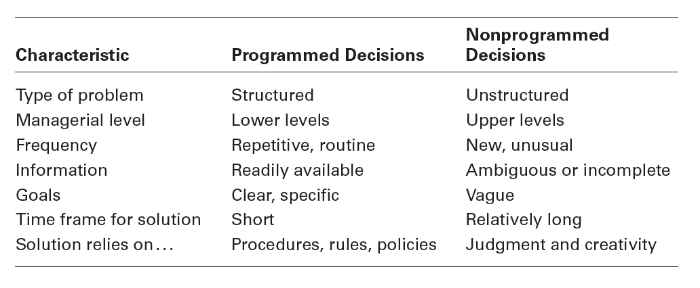
fIGURA 2-7
DECISÕES PROGRAMADAS VS
DecISÕES NÃO PROGRAMADAS
Notes:
Exhibit 2-7 describes the differences between programmed and nonprogrammed decisions. Lower-level managers mostly rely on programmed decisions (procedures, rules, and policies) because they confront familiar and repetitive problems. As managers move up the organizational hierarchy, the problems they confront become more unstructured.

Slide 32
CONDIÇÕES /CONTEXTO DO PROCESSO DE DECISÃO
Certeza – situação em que os resultados de todas as alternativas são conhecidos pelo decisor.
Risco – situação em que os o decisor consegue estimar a probabilidade (esperada/aproximada) de acontecimento dos resultados para todas as alternativas.
Incerteza - situação em que os o decisor não consegue estimar a probabilidade (esperada/aproximada) de acontecimento dos resultados para todas as alternativas.

Slide 33
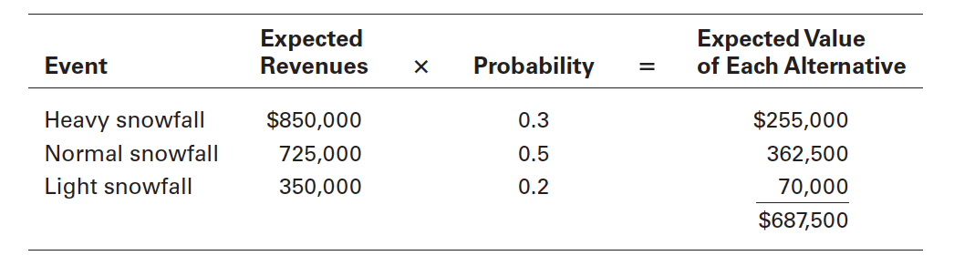
fIGURA 2-8
VALOR ESPERADO

Slide 34
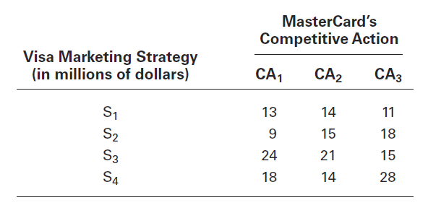
FIGURA 2-9
MatriZ DE RESULTADOS
Notes:
A marketing manager at Visa has determined four possible strategies (S1, S2, S3, and S4) for promoting the Visa card throughout the West Coast region of the United States. The marketing manager also knows that major competitor MasterCard has three competitive actions (CA1, CA2, and CA3) it’s using to promote its card in the same region. For this example, we’ll assume that the Visa manager had no previous knowledge that would allow her to determine probabilities of success of any of the four strategies. She formulates the matrix shown in Exhibit 2-9 to show the various Visa strategies and the resulting profit, depending on the competitive action used by MasterCard.

Slide 35
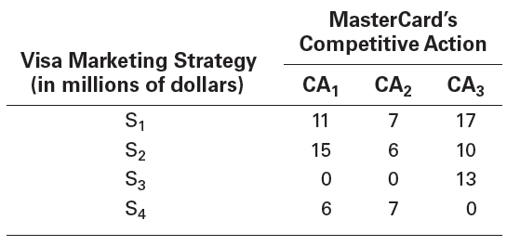
FIGURA 2-10
MatriZ DO ARREPENDIMENTO

Slide 36
ESTILOS DE TOMADA DE DECISÃO
Pensamento linear – a tendência para usar dados/factos externos e processar a informação de forma lógica e racional.
Pensamento não linear - a tendência para usar fontes internas, como ideias, sentimentos e palpites, para processar a informação.
Notes:
Your thinking style reflects two things: (1) the source of information you tend to use (external data and facts OR internal sources
such as feelings and intuition), and (2) whether you process that information in a linear way (rational, logical, analytical) OR a nonlinear way (intuitive, creative, insightful). These four dimensions are collapsed into two styles. The first, linear thinking style, is characterized by a person’s preference for using external data and facts and processing this information through rational, logical thinking to guide decisions and actions. The second, nonlinear thinking style, is characterized by a preference for internal sources of information (feelings and intuition) and processing this information with internal insights, feelings, and hunches to guide decisions and actions.

Slide 37
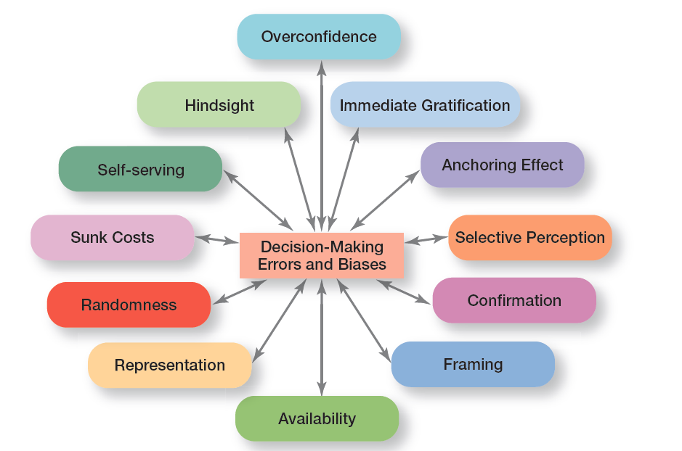
FIGURA 2-11
ERROS E ENVIESAMENTOS MAIS COMUNS

Slide 38
LINHAS ORIENTADORAS PARA UM PROCESSO DE TOMADA DE DECISÃO EFICAZ
Perceber as diferenças culturais.
Criar critérios de referência para um bom processo de tomada de decisão.
Saber quando é a altura de parar e desistir de uma solução/decisão.
Usar um processo de tomada de decisão que seja eficiente e eficaz.
Construir uma organização atenta ao inesperado e capaz de rapidamente se adaptar à mudança.
Notes:
Decision-making is serious business. Your abilities and track record as an effective decision maker will determine how your organizational work performance is evaluated and whether you’ll be promoted to higher and higher positions of responsibility. Below are some guidelines to help you be a better decision maker.
Understand cultural differences. Managers everywhere want to make good decisions. However, is there only one “best” way worldwide to make decisions? Or does the “best way depend on the values, beliefs, attitudes, and behavioral patterns of the people involved?”
Create standards for good decision making. Good decisions are forward-looking, use available information, consider all available and viable options, and do not create conflicts of interest.
Know when it’s time to call it quits. When it’s evident that a decision isn’t working, don’t be afraid to pull the plug.
Use an effective decision-making process.
Build an organization that can spot the unexpected and quickly adapt to the changed environment.

Slide 39

Design ThINKING E O PROCESSO DE TOMADA DE DECISÃO
Design thinking
Abordar os problemas de gestão como os designers abordam os problemas de design.
Notes:
The way managers approach decision-making—using a rational and analytical mindset in identifying problems, coming up with alternatives, evaluating alternatives, and choosing one of those alternatives—may not be best and certainly not the only choice in today’s environment. That’s where design thinking comes in. Design thinking has been described as “approaching management problems as designers approach design problems.”
Korean carmaker Hyundai decided to take the design thinking approach in testing the durability and quality of its i30 hatchback family car by letting a group of forty safari park baboons examine it for ten hours. Hyundi hopes that the lessons learned from the excessive wear- and - tear test of the car’s parts and interior can be applied to the research and development of future cars.

Slide 40


